Slide 1
Manajemen Aplikasi
© B.Very Christioko, S.Kom

Slide 2
Package Manager di Linux
Yang disebut paket manager adalah sekumpulan tools / aplikasi yang digunakan untuk otomatisasi proses instalasi, upgrade (memperbaharui), dan remove (menghapus) dari paket perangkat lunak (software) atau aplikasi.
Paket manager bisa berupa GUI (Graphic User Interface / tampilan grafis) atau CLI (Command Line Interface / berbasis perintah baris.
© B.Very Christioko, S.Kom

Slide 3
REDHAT → .rpm
Package Manager: RPM Package manager
Install
rpm -i [option] [nama_paket_rpm]
List
rpm -q [option] [nama_paket]
Uninstall
rpm -e [option] [nama_paket]
© B.Very Christioko, S.Kom

Slide 4
DEBIAN → .deb
Package Manager: Dpkg
Install
dpkg -i [nama_paket].deb
List
dpkg -l [optional pattern]
Uninstall
dpkg -r [nama_paket]
© B.Very Christioko, S.Kom

Slide 5
Package Manager: APT (Advanced Packaging Tool)
apt-get update
Updates apt-get's local database with server's pkglist's files.
apt-get check
verifies system's integrity using apt
apt-get install some-package
installs some new package, automatically resolving and downloading dependent packages
apt-get upgrade
checks for outdated packages in the system and automatically upgrades them
apt-get dist-upgrade
same as apt-get upgrade, but installs all base packages and tries to upgrade everything, installing new packages if needed
apt-get remove some-package
removes the some-package package and all other packages that depends on it
apt-get clean
removes the downloaded packages from the cache directory (/var/cache/apt/archives/), freeing some disk space at your system ;-)
© B.Very Christioko, S.Kom

Slide 6
SLACKWARE → .tgz
Package Manager: installpkg, removepkg, upgradepkg
Install
installpkg [nama_paket].tgz
Uninstall
removepkg [nama_paket]
© B.Very Christioko, S.Kom

Slide 7
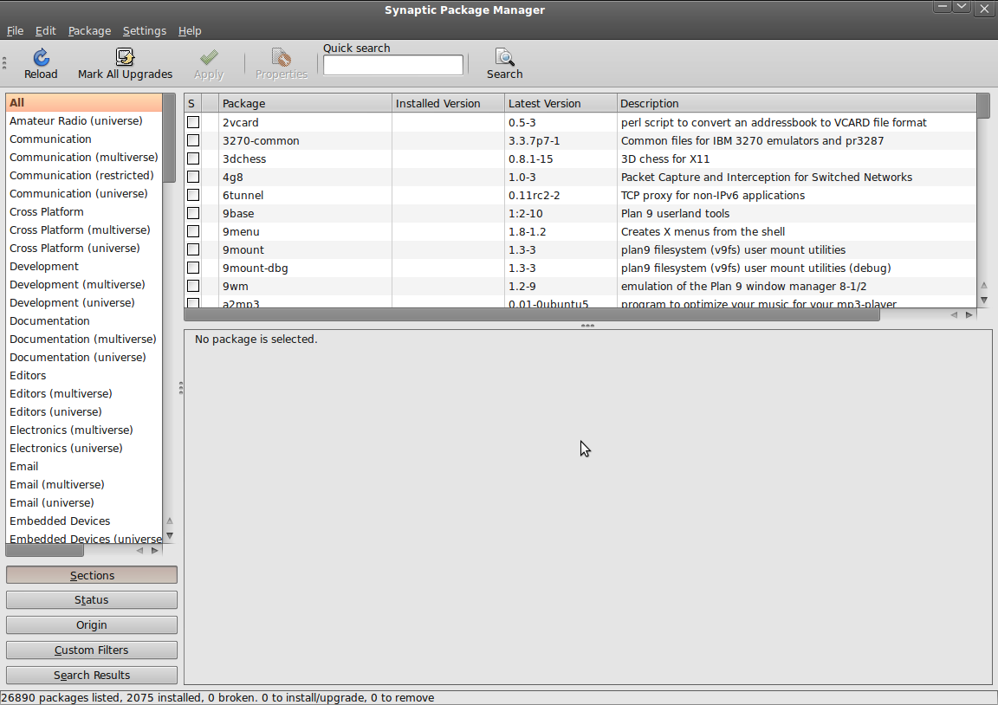
Synaptic Package Manager di Debian
© B.Very Christioko, S.Kom

Slide 8
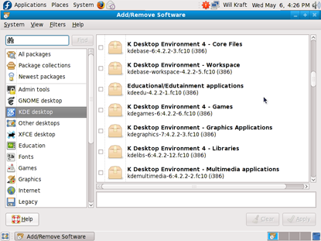
YUM Package Manager di Fedora
© B.Very Christioko, S.Kom

Slide 9
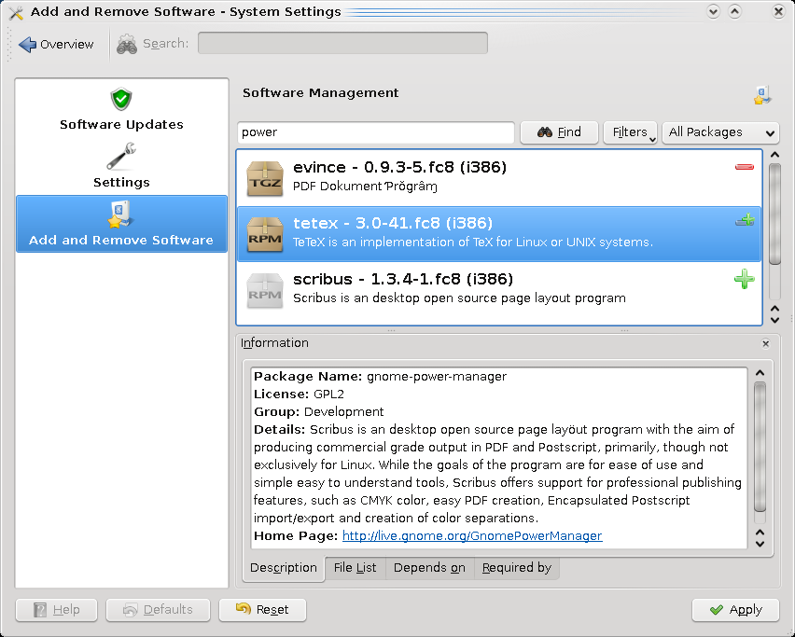
PacketKit, aplikasi package manager yang digunakan oleh Fedora, OpenSUSE, Kubuntu
© B.Very Christioko, S.Kom

